Slide 1

Predictive Analytics in Business (BUAN 448)
Neural Networks
BUAN 488 – Fall 2022 – Dr. Davoodi

Slide 2
Agenda
Neural Networks
Concept and Structure of a Neural Network
Example: Cheese (Tiny Dataset)
Computing Output of Nodes
Relation to Linear/Logistic Regression
Preprocessing the Data
Training the Model
Avoiding Overfitting
Using the NN Output for Prediction and Classification
Required User Input
Summary

Slide 3

What is neural network?
Also called “Artificial Neural Network”
It is based on a model of biological activity in the brain, where neurons are interconnected and learn from experience

Slide 4
Neural network applications
Financial applications: bankruptcy predictions, currency market trading, picking stocks and commodity trading, detecting fraud in credit card, customer relationship management (CRM)
Engineering applications: ALVINN (An Autonomous Land Vehicle in a Neural Network)

Slide 5
Why neural network?
Neural network has high predictive performance!
The structure captures very complex relationships between predictors and an outcome variable, which is not often not possible with other predictive models

Slide 6
Concept and Structure of a Neural Network

Slide 7
Model Comparison
Regression model: we might try different transformations of the predictors, but the specified form of the relationship remains the same
Neural network: the users are not required to specify the correct form. Instead, the network tries to learn about such relationship from the data
Linear regression and logistic regression can be thought as special cases of very simple neural networks

Slide 8
Neural Network: Basic Idea
Combine input information in a complex & flexible neural net “model” (a “black box”)
Model “coefficients” are continually tweaked in an iterative process
The network’s interim performance in classification and prediction informs successive tweaks

Slide 9
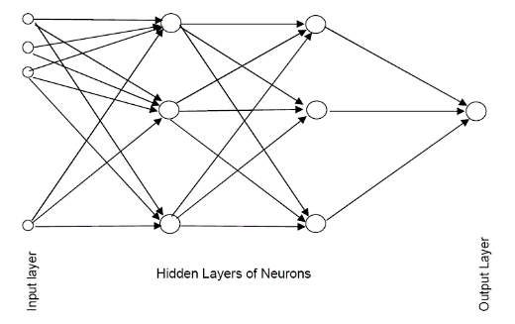
Neural Network
Multiple layers
Input layer (raw observations)
Hidden layers
Output layer
Nodes (also called “neurons”)
Weights (like coefficients, subject to iterative adjustment)
Bias values (also like coefficients, but not subject to iterative adjustment)
A feedforward network is a fully connected network with a one-way flow and no cycles.
Multilayer Feedforward Networks

Slide 10
Example: Cheese (Tiny Dataset)

Slide 11
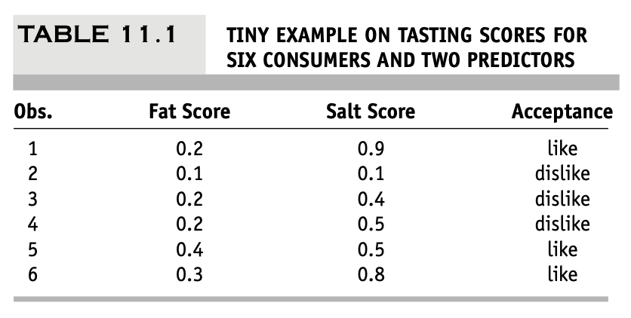
Example - fat & salt content
Goal: predict consumer acceptance of cheese
Predictors: scores for fat and salt, indicating the relative presence of fat and salt in the cheese sample (0: minimum amount possible in the manufacturing process; 1: the maximum)
Outcome variable: consumer’s taste preference (like or dislike)

Slide 12
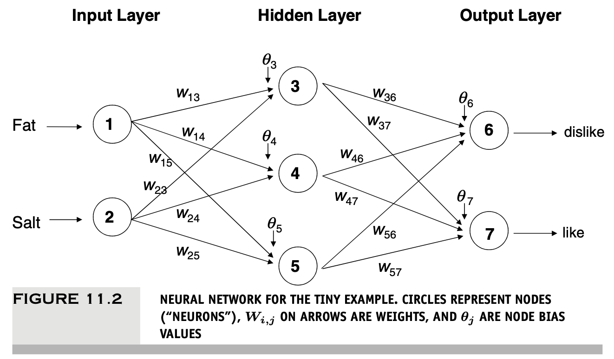
Example - Cont. Proposed Neural Network

Slide 13
Computing Output of Nodes

Slide 14
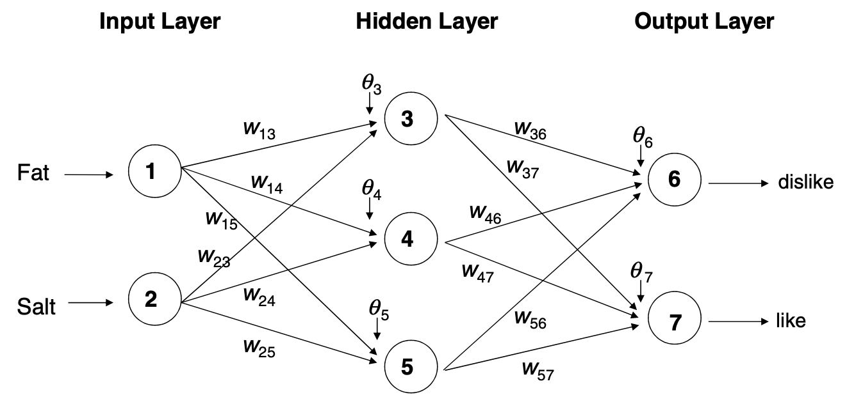
The Input Layer
For input layer, input = output
(Input nodes take as input the values of the predictors)
E.g., for record #1:
Fat input = output = 0.2
Salt input = output = 0.9
Output of input layer = input into hidden layer
If we have p predictors, the input layer will usually include p nodes

Slide 15
The Hidden Layer
In this example, hidden layer has 3 nodes
Each node receives as input the output of all input nodes
Output of each hidden node is a function of the weighted sum of inputs
transfer function or activation function

Slide 16
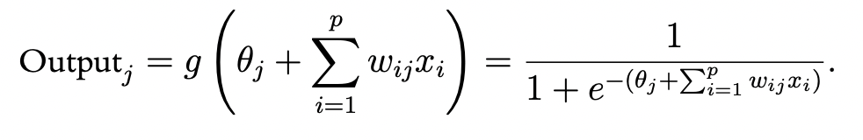
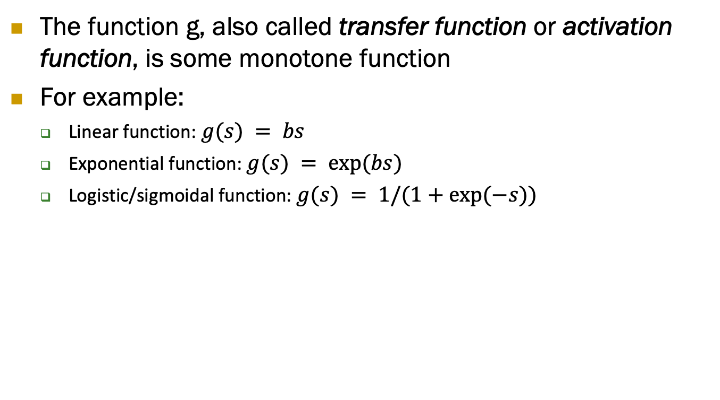
Function g
The function g, also called transfer function or activation function, is some monotone function
For example:
Linear function: $g(s) = bs$
Exponential function: $g(s) = exp⁡(bs)$
Logistic/sigmoidal function: $g(s) = 1/(1+exp⁡(−s))$

Slide 17
The Weights
The weights θ (the bias of the node) and w are typically initialized randomly, then adjusted as the network “learns”
The weights are initialized to small numbers usually in the range 0.00 +/- 0.05, representing a state of no knowledge or a model with no predictors
The initial weights are used in the first round of training
Note that: θ is a constant that controls the level of the contribution of each node

Slide 18
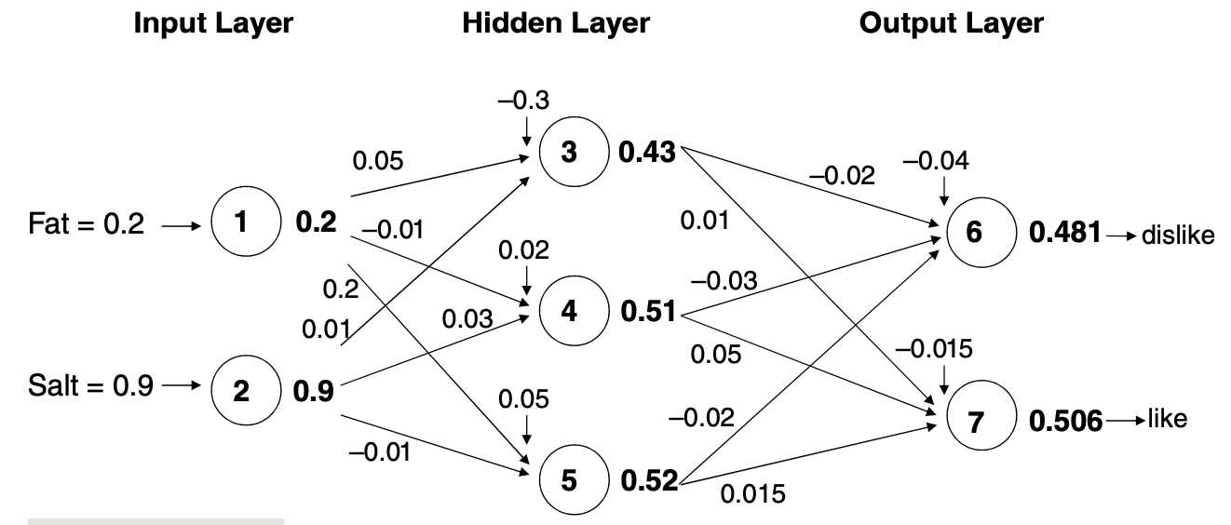
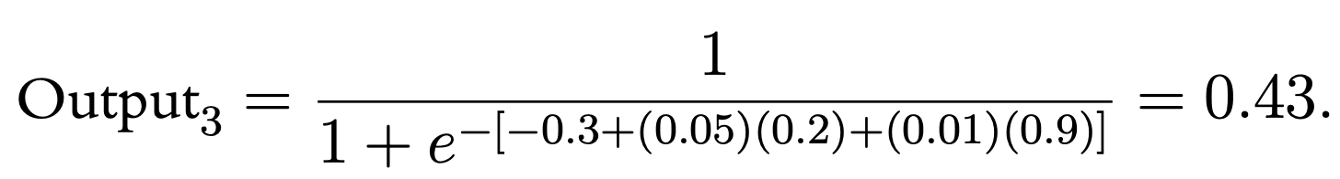
Initial Pass of the Network

Slide 19
Output Layer
The output of the (last) hidden layer becomes input for the output layer
It applies the same function as above to create the output

Slide 20
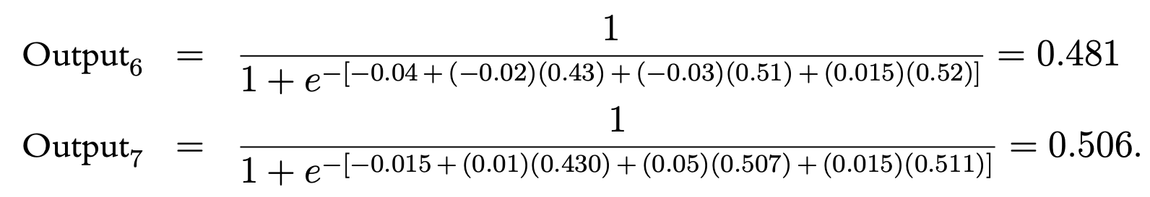
The output node

Slide 21
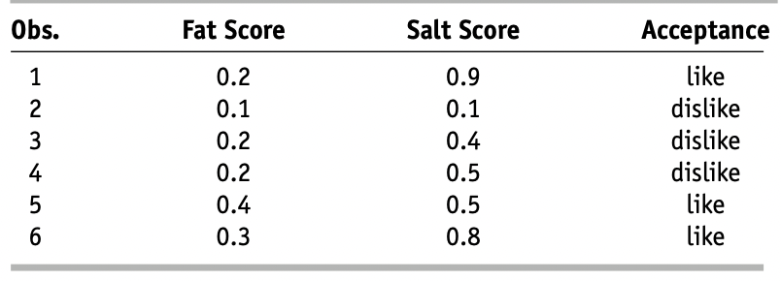
Mapping the output to a classification
In this example, the Output = 0.506 (If cutoff for a “1” is 0.5, then we classify as “1”)
The last step may involve normalizing two values so that they add up to 1

Slide 22
Relation to Linear/Logistic Regression

Slide 23

Relation to Linear Regression
A net with a single output node and no hidden layers
g is the identity function [$g(s) = s$], takes the same form as a linear regression model
Identity Function $g(s) = s$ is the simplest activation function

Slide 24
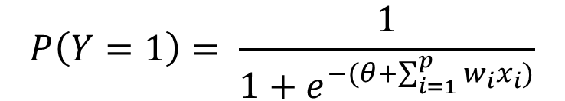
Relation to Logistic Regression
A net with a single output node and no hidden layers
Y is binary
g is the logistic function, takes the same form as a logistic regression model
$$P\left(Y=1\right)= \frac{1}{1+e^{−(θ+\sum_{i=1}^{p}{w_{i}x_{i}})}}$$

Slide 25
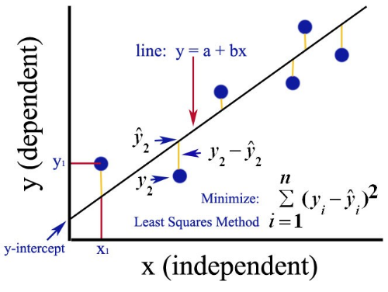
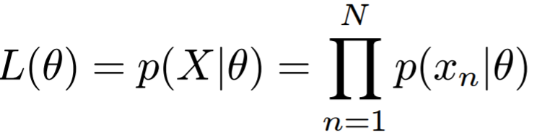
Relation to Linear/Logistic Regression
The estimates for weights are different!
Recall:
Linear regression: least squares
Logistic regression: maximum likelihood
https://medium.com/analytics-vidhya/ordinary-least-square-ols-method-for-linear-regression-ef8ca10aadfc

Slide 26
Preprocessing the Data

Slide 27
Preprocessing Steps
When using a logistic activation function (option act.fct = ’logistic’ in R),
NN performs best when the predictors and outcome variables are on a scale of [0,1]
We need to scale all the variables to 0-1 before entering them into the network!

Slide 28

Preprocessing Steps
Numerical variable X that takes values in [a,b], where a<b, the normalized measurement is:
$X_{norm}$= $\frac{X −a}{b−a}$

Slide 29
Preprocessing Steps
Categorical variables
Binary variable: create dummy variables
For an ordinal variable with m categories:
A choice of m fractions in [0,1]
For example: if there are four ordinal categories [0, 0.25, 0.5, 1]
Nominal variable: create m-1 dummy variables

Slide 30
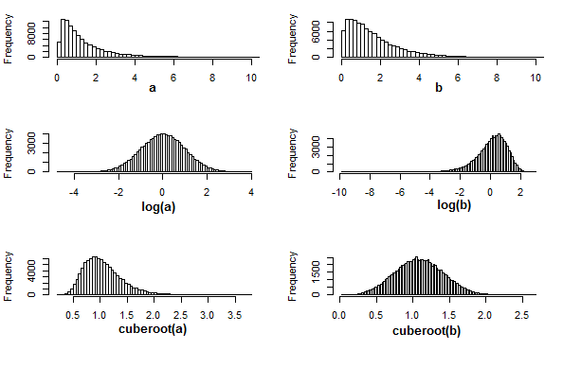
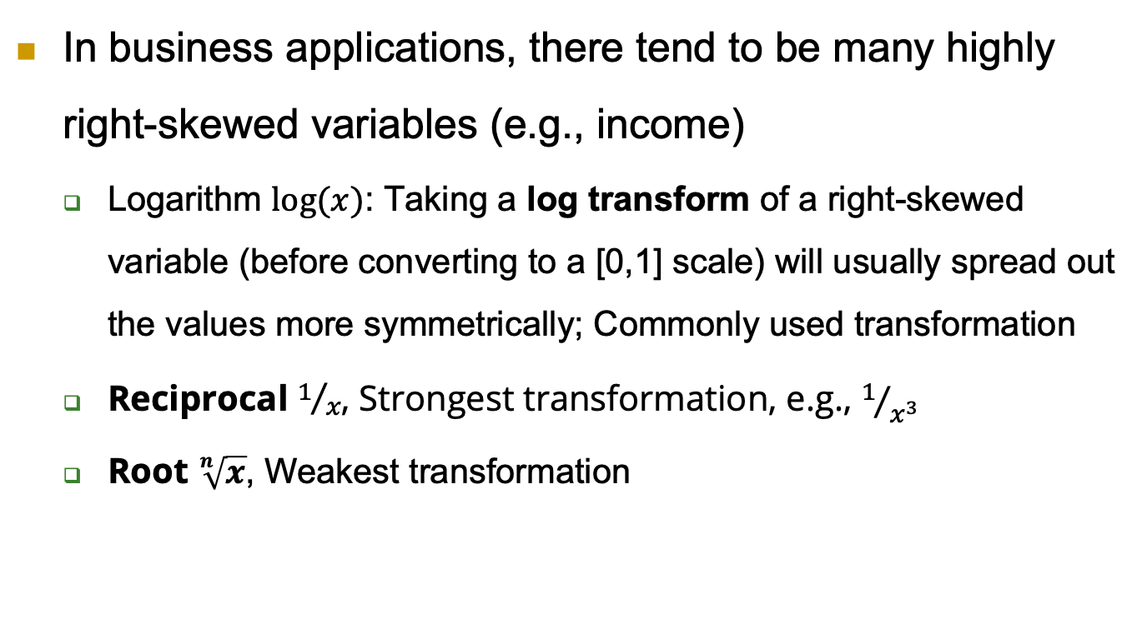
Transform highly skewed predictors
In business applications, there tend to be many highly right-skewed variables (e.g., income)
Logarithm $log⁡(x)$: Taking a log transform of a right-skewed variable (before converting to a [0,1] scale) will usually spread out the values more symmetrically; Commonly used transformation
Reciprocal $1/x$, Strongest transformation, e.g., $1/{x^{3}}$
Root $\sqrt[n]{x}$, Weakest transformation

Slide 31
Transform highly skewed predictors
If data distribution is highly left-skewed
Subtracting all observation from the maximum value + 1.
Square x². Stronger with higher power.
Exponential eˣ. Strongest transformation

Slide 32
Training the Model

Slide 33
Initial Pass-Through Network
Goal: Find weights (θ and w) that yield the best predictions
The process we described above is repeated for all records
At each record, compare prediction to actual (their difference is the error for the output node)
The estimation process uses the errors iteratively to update the estimated weights

Slide 34

Back Propagation of Error (The most popular algorithm)
Output from output node k: $y_{k}$
$y_{k}$ is 1 or 0 (actual value/label/class)
Error associated with that node:

Slide 35
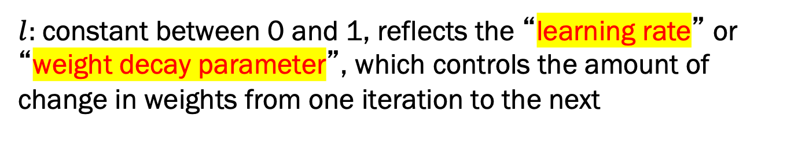
Error is Used to Update Weights
$l:$constant between 0 and 1, reflects the “learning rate” or “weight decay parameter”, which controls the amount of change in weights from one iteration to the next

Slide 36
Why It Works
Big errors lead to big changes in weights
Small errors leave weights relatively unchanged
Over thousands of updates, a given weight keeps changing until the error associated with that weight is negligible, at which point weights change little

Slide 37
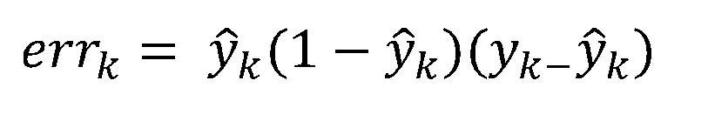
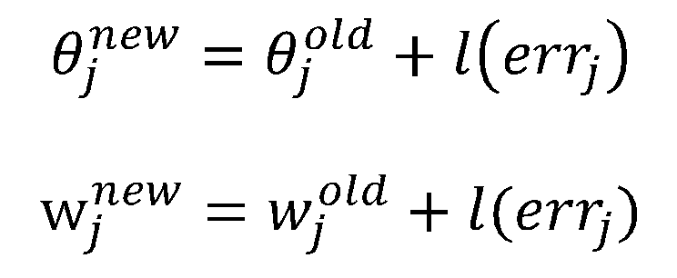


In our example:
Error for node 7:
$$0.506\left(1−0.506\right)\left(1−0.506\right)=0.123$$
Assuming:
Learning rate = 0.5
$$θ7=−0.015+0.5 \left(0.123\right)=0.047$$
$$w_{3,7}=0.01+0.5 \left(0.123\right)=0.072$$

Slide 38
Methods for updating the weights
Case updating
Batch updating

Slide 39
Case Updating
Weights are updated after each record is run through the network
Completion of all records through the network is called
one iteration,
one epoch,
one sweep
After one iteration is completed, return to first record and repeat the process
Typically, there are many iterations! (accurate but time consuming)

Slide 40
Batch Updating
All records in the training set are fed to the network before updating takes place
In this case, the error used for updating is the sum of all errors from all records

Slide 41
Common Criteria to Stop the Updating
When weights change very little from one iteration to the next
When the misclassification rate reaches a required threshold
When a limit on runs is reached

Slide 42
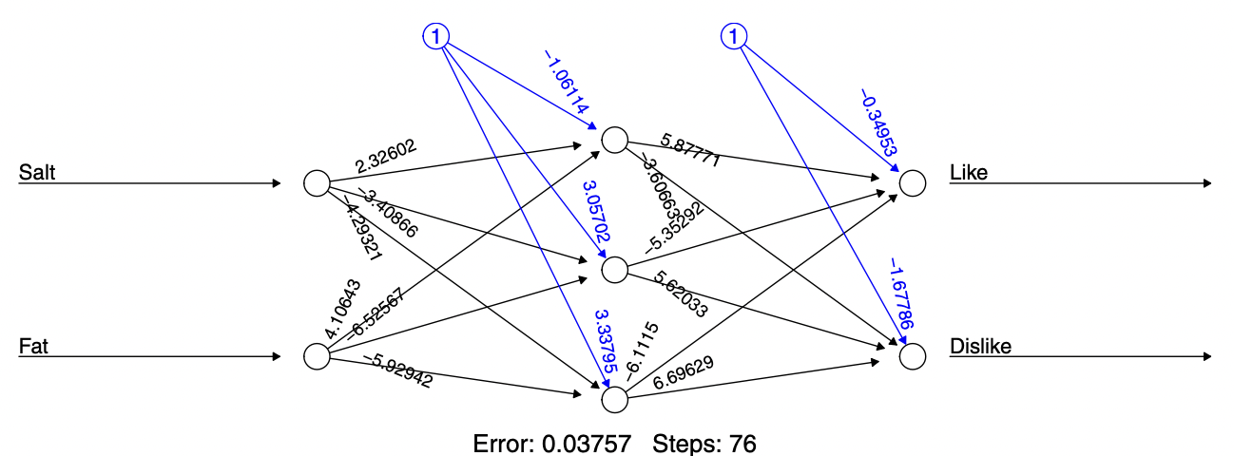
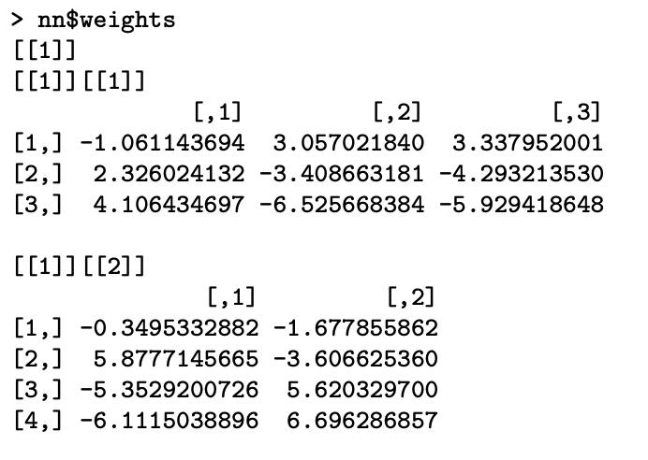
Outputs: Final Weights

Slide 43
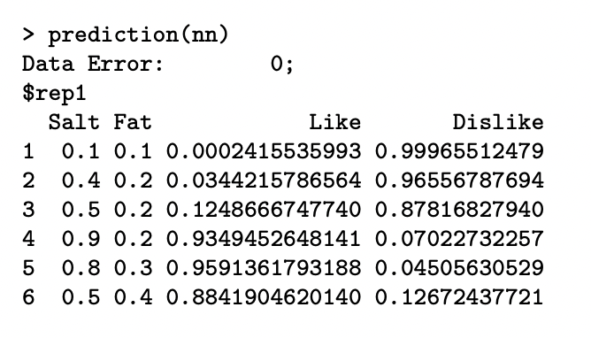
Outputs: Final Classifications

Slide 44
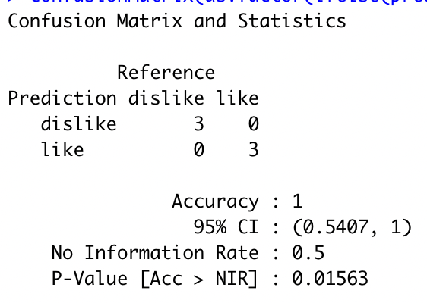
Outputs: Final Classifications
The performance of the neural network
Using confusion matrix

Slide 45
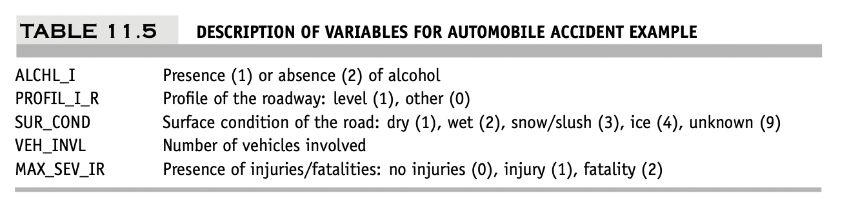
Example
US automobile accidents are classified by their level of severity as
no injury,
injury, or
fatality.
A firm might be interested in developing a system for quickly classifying the severity of an accident, based on
initial reports and
associated data in the system.

Slide 46
Example
The number of nodes in the input layer
Seven nodes (neurons)
One node for Alcohol
One node for roadway
Four nodes for surface
One node for vehicles
The number of neurons in the output layer
Three neurons
One node for no injuries
One node for injury
One node for fatality

Slide 47
Avoiding Overfitting

Slide 48
Avoiding Overfitting
With sufficient iterations, neural net can easily overfit the data
To avoid overfitting:
Track error in validation data, especially on new data
Limit the number of training iterations
Limit complexity of network

Slide 49
Using the Output for Prediction and Classification

Slide 50
Interpret the NN output
Resulting output needs to be scaled back to the original units if predicting a numerical outcome
we multiply the network output by b − a and add a.
When predicting classification
Obtain an output from each of the m output nodes (or m − 1 output nodes) How do we translate them m outputs?
Usually, the output node with the largest value determines the net’s classification.
In the case of a binary outcome (m = 2)
consider cutoff of 0.5 ,
An alternative is to use the validation set to determine a cutoff

Slide 51
Required User Input

Slide 52
Specify Network Architecture
Number of hidden layers
Most popular – one hidden layer
Number of nodes in hidden layer(s)
More nodes capture complexity, but increase chances of overfit
Rule of thumb: start with p (number of predictors) nodes and gradually decrease/increase while checking for overfitting

Slide 53
Specify Network Architecture
Number of output nodes
For classification, one node per class (in binary case can also use one)
For categorical outcome with m classes, m or m-1 nodes
For numerical prediction use one

Slide 54
Network Architecture, cont.
Choice of predictors
The neural networks are highly dependent on the quality of their input
The choice of predictors should be done carefully
Domain knowledge, variable selection, dimension reduction…
“Learning Rate” (L)
Low values “down weight” the new information from errors at each iteration
This slows learning, but reduces tendency to overfit to local structure

Slide 55
Summary

Slide 56
Advantages
Good predictive performance
Can capture complex relationships
No need to specify a model

Slide 57
Disadvantages
Considered a “black box” prediction machine, with no insight into relationships between predictors and outcome
No variable-selection mechanism, so you must exercise care in selecting variables
Neural networks rely heavily on having sufficient data for training purposes.
Heavy computational requirements if there are many variables (additional variables dramatically increase the number of weights to calculate)

Slide 58
Summary
Neural networks can be used for classification and prediction
Can capture a very flexible/complicated relationship between the outcome and a set of predictors
The network “learns” and updates its model iteratively as more data are fed into it
Major danger: overfitting
Requires large amounts of data
Good predictive performance, yet “black box” in nature

